Slide 1
SENG 1000 - Software Engineering Foundations and Practice
-Sumati

Slide 2
Topics
Errors and Exceptions
Syntax Errors
Exceptions
Handling Exceptions
Explicitly Raising an Exception
Stack Unwinding and Tracebacks

Slide 3
Errors
There are two distinguishable kinds of errors:
Syntax errors
Exceptions

Slide 4
Syntax Errors
Syntax errors
They are also known as parsing errors
The most common kind of complaint you get while you are still learning Python
Example:
>>> while True print('Hello world')
File "<stdin>", line 1
while True print('Hello world')
^
SyntaxError: invalid syntax

Slide 5
Exceptions
Errors detected during execution are called exceptions and are not unconditionally fatal
You will soon learn how to handle them in Python programs.
Even if a statement or expression is syntactically correct, it may cause an error when an attempt is made to execute it.
Most exceptions are not handled by programs, however, and result in error messages.
Example:
>>> 10 * (1/0)
Traceback (most recent call last):
File "<stdin>", line 1, in <module>
ZeroDivisionError: division by zero

Slide 6
Exceptions (Examples contd..)
>>> 4 + spam*3
Traceback (most recent call last):
File "<stdin>", line 1, in <module>
NameError: name 'spam' is not defined
>>> '2' + 2
Traceback (most recent call last):
File "<stdin>", line 1, in <module>
TypeError: Can't convert 'int' object to str implicitly

Slide 7
Exception Handling
Exception Handler
Writing handler code that responds to exceptions when they are raised
This prevents the program from abruptly crashing

Slide 8
try-catch Syntax
try:
statement
statement
statement etc.
except ExceptionName:
statement
statement
statement etc.

Slide 9
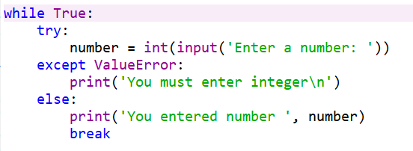
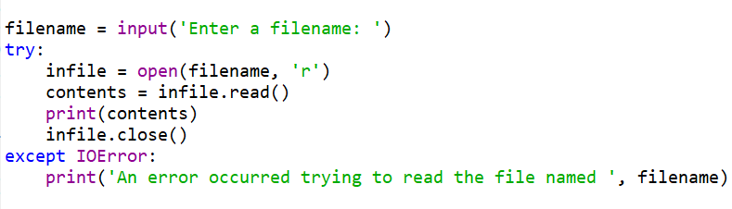
Example

Slide 10
Handling Multiple Exceptions
In many cases, the code in a try block will be capable of throwing more than one type of exception.
In such a case, you need to write an except clause for each type of exception that you want to handle.

Slide 11
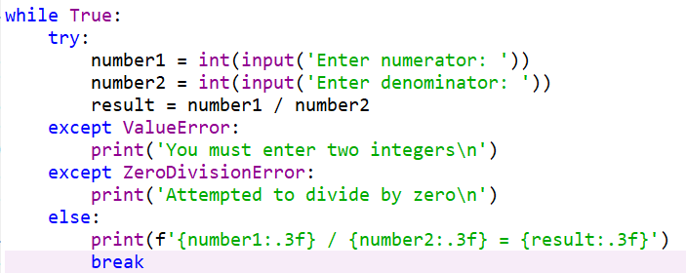
Example

Slide 12
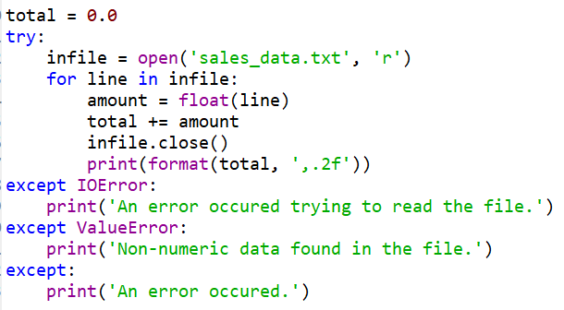
Using multiple except clause

Slide 13
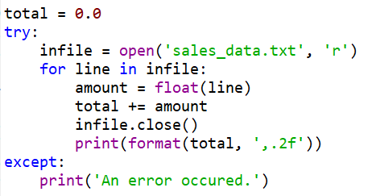
Using one except clause

Slide 14
Displaying an Exception’s Default Error Message
When an exception is thrown, an object known as an exception object is created in memory.
The exception object usually contains a default error message pertaining to the exception.
except ValueError as err:
print(err)
except Exception as err:
print(err)

Slide 15
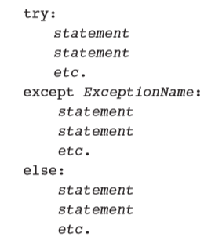
The else Clause
The try/except statement may have an optional else clause.
This appears after all the except clauses.

Slide 16
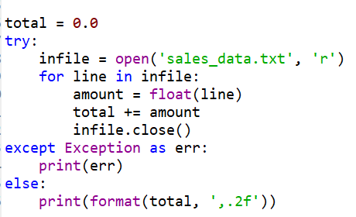
The else Clause : Example

Slide 17
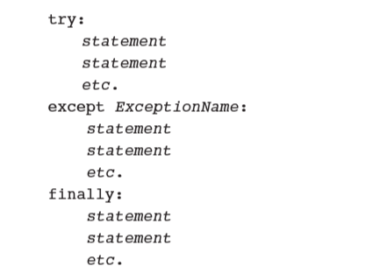
The finally Clause
The try/except statement may have an optional finally clause
This must appear after all the except clauses.

Slide 18
What If an Exception Is Not Handled?
If an exception is not handled, it will cause the program to halt.
There are two possible ways for a thrown exception to go unhandled.
If try/except statement has no except clauses of the right type.
If the exception is raised from outside a try block.

Slide 19
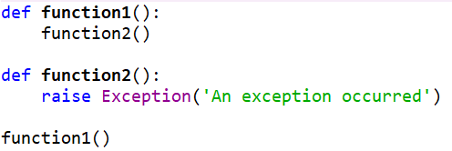
Explicitly Raising an Exception
Sometimes you might need to write functions that raise exceptions to inform callers of errors that occur
raise statement explicitly raises an exception
raise ExceptionClassName

Slide 20
Raising an Exception
Creates an object of the specified exception class
Exception class name may be followed by parentheses containing arguments to initialize the exception object—typically a custom error message string
Code that raises an exception first should release any resources acquired before the exception occurred

Slide 21
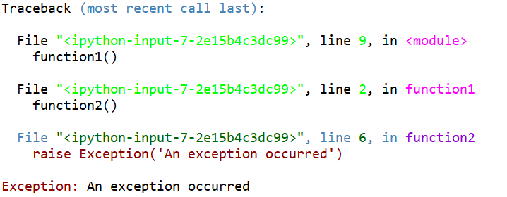
Stack Unwinding and Tracebacks
Each exception object stores information indicating the precise series of function calls that led to the exception
Helpful when debugging your code

Slide 22
Summary
This chapter covered:
Syntax Errors
Exceptions
Handling Exceptions
try-catch Syntax
Handling Multiple Exceptions
Displaying an Exception’s Default Error Message
The finally Clause
Explicitly Raising an Exception
Stack Unwinding and Tracebacks

